Slide 1
Computational Models
Definition
Categories of model
Model Selection
Model evaluation
Learning model parameters

Slide 2
Model Variables
State variables: It describes the future behavior of the system.
Output variables: It relates to the unobserved state variables .
Decision variables: They are able to control the interactions between the constituent components of the system.
Constant variables: They are auxiliary variables that affect the structure of the system.

Slide 3
Model Equations
State equations: It describe how the values of the state variables will change.
Observation equations: It describe the mathematical relationship among model variables.
Defining equations: It define new variables in terms of the ones that are already known.
Constraints It describe the phenomenon of interest through a set of conditions that must be satisfied among the variables.

Slide 4
Categories of Model
EXPLICT VS IMPLICT
RULE BASED
LINEAR VS. NONLINEAR
DETERMINISTIC VS. PROBABILISTIC (STOCHASTIC)
DYNAMIC VS. STATIC
DISCRETE VS. CONTINUOUS
DECISION MAKING MODELS

Slide 5
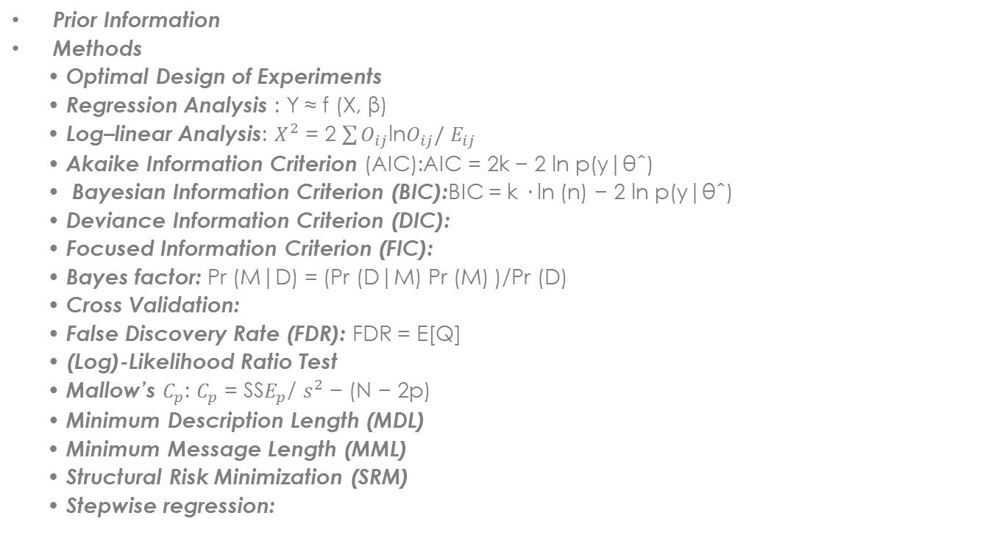
Model Selection
Prior Information
Methods
• Optimal Design of Experiments
• Regression Analysis : Y ≈ f (X, β)
• Log–linear Analysis: $X^{2}$ = 2 $\sum{O_{ij}}$ln$O_{ij}/$ $E_{ij}$
• Akaike Information Criterion (AIC):AIC = 2k − 2 ln p(y|θˆ)
• Bayesian Information Criterion (BIC):BIC = k · ln (n) − 2 ln p(y|θˆ)
• Deviance Information Criterion (DIC):
• Focused Information Criterion (FIC):
• Bayes factor: Pr (M|D) = (Pr (D|M) Pr (M) )/Pr (D)
• Cross Validation:
• False Discovery Rate (FDR): FDR = E[Q]
• (Log)-Likelihood Ratio Test
• Mallow’s $C_{p}$: $C_{p}$ = SS$E_{p}$/ $s^{2}$ − (N − 2p)
• Minimum Description Length (MDL)
• Minimum Message Length (MML)
• Structural Risk Minimization (SRM)
• Stepwise regression:

Slide 6
Model Evaluation
Evaluating whether the model selected is accurate or not?
First we need to evaluate if the model we selected is consistent with available data.
Factors need to be also considered while evaluating a model: consistency with unknown data
generalizability,
complexity,
degree of confidence,
cost.
In general, a good model should be able to balance accuracy with all or subset of the above factors.

Slide 7
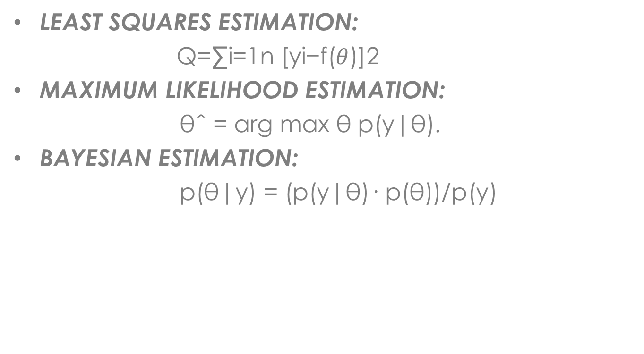
Learning Model Parameters
LEAST SQUARES ESTIMATION:
Q=∑i=1n [yi−f($θ$)]2
MAXIMUM LIKELIHOOD ESTIMATION:
θˆ = arg max θ p(y|θ).
BAYESIAN ESTIMATION:
p(θ|y) = (p(y|θ)· p(θ))/p(y)

